Slide 1


Abstra
Lazar Milicevic
Weekly support report
Support, Challenges, Sollutions
15.03.2025

Slide 2
Agenda
1. Zendesk Ticket Management & Optimization
3. Infra & Product Coordination
5. Visual & Helpdesk Improvements
2. Fullstory & Dashboard Updates
4. Reported & Tracked Issues
6. Next steps

Slide 3

Zendesk Ticket Management & Optimization
Customer success: Weekly Support Report – 15.03.2025
What was done:
✅ 3-Strike Rule implemented for pending tickets:
Strike 1 (2 days): reminder
Strike 2 (5 days): final warning
Strike 3 (7 days): auto-close
Internal announcement posted on Slack
✅ New macro created for dataset licensing cases:
Includes standardized response and link to shared folder
⚠ Help Center access temporarily restricted:
Only available to JumpCloud-authenticated users
Will be public after documentation and design review
Slack thread for context

Slide 4
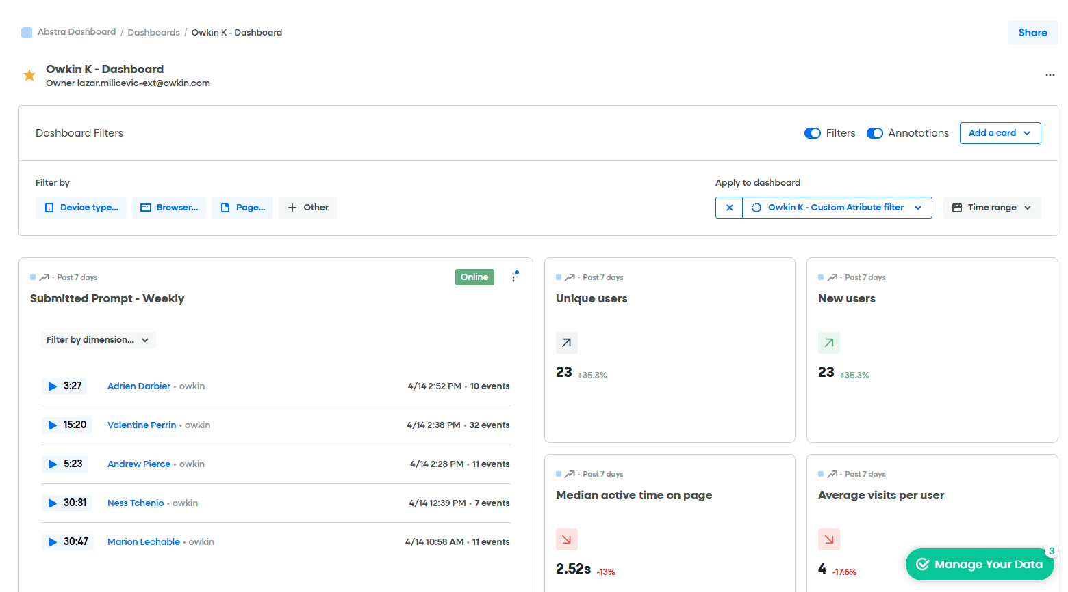
Fullstory & Dashboard Updates
Customer success: Weekly Support Report – 15.03.2025
Where we are now ?
✅ Custom attribute (product = k-navigator) is now live in Owkin K production
📊 Dashboard now shows accurate data filtered only to Owkin K: View here
⚠ Data is not retroactive — tracking starts from April 11, which explains low user counts initially
🔄 Historical comparisons are not valid due to segmentation change
🧭 Exploring separate Fullstory accounts per product if needed for long-term clarity

Slide 5
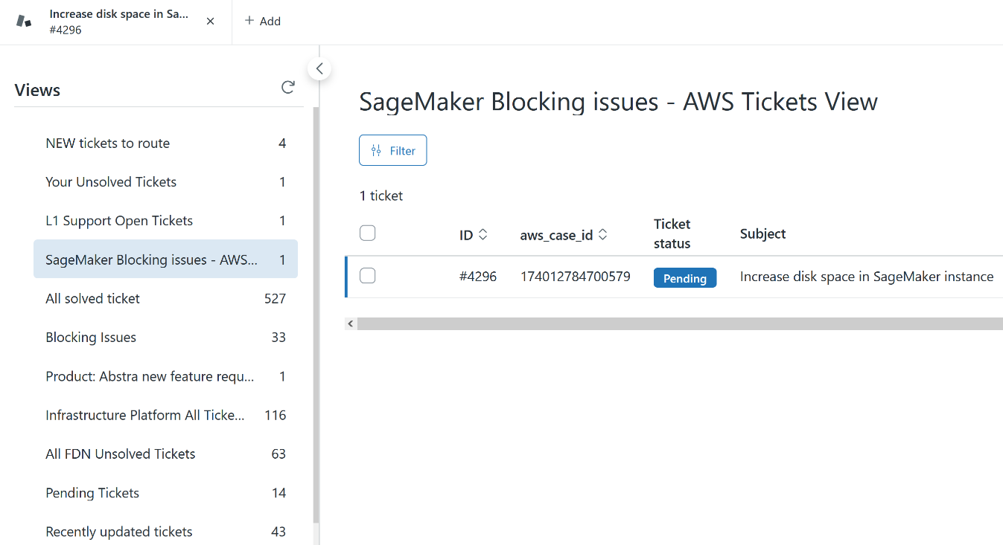
Infra & Product Coordination
Customer success: Weekly Support Report – 15.03.2025
Some of them:
🔄 AWS support flow updated after sync with Matthieu (SRE):
Automatic ticket forwarding to AWS has been disabled.
All SageMaker-related tickets now go through internal triage in Zendesk before being escalated.
A new squad value "AWS Support" has been added to enable manual handoff when needed.
This change aims to reduce noise from generic replies and ensure better ownership and relevance.
📌 This new setup is now fully live:
All form submissions for SageMaker now land in our internal triage view.
I perform the first review of every ticket and forward to AWS only when relevant.
Users are no longer exposed to automated or irrelevant replies from AWS.

Slide 6
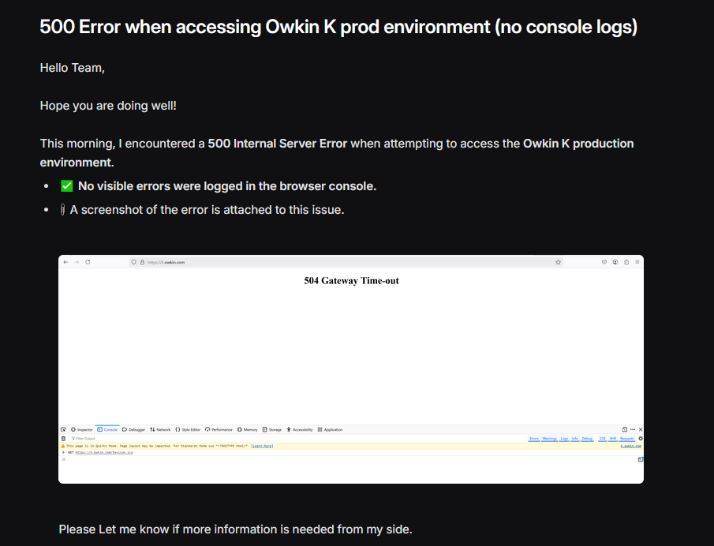
Reported & Tracked Issues
Customer success: Weekly Support Report – 15.03.2025
What was done:
❗ Owkin K - 500 Error (no logs)
Tracked via Linear K-673
✅ SurveySparrow Bug
Widget doesn't close after submission
Responses still recorded successfully
Tracked via Linear K-636
Related Zendesk ticket: #4744

Slide 7
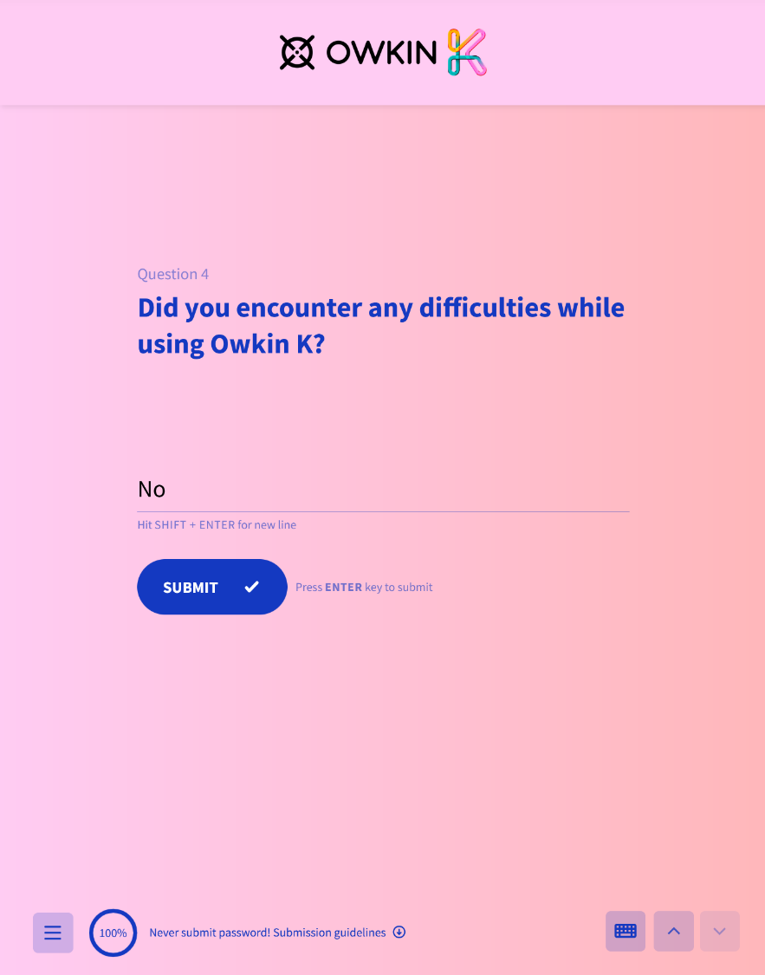
Visual & Helpdesk Improvements
Customer success: Weekly Support Report – 15.03.2025
What will be done:
✅ Design updates completed on Help Center
New logo, background banners, and beige background #FAF3EB
Design team confirmed everything looks and works as expected
🗓 Owkin K Support Sync – Émilie Boissady
Reviewed triage structure, support flow, and documentation status
🗓 SageMaker Escalation Policy – Matthieu (SRE)
Confirmed shift to internal triage model
Finalized process changes and shared with Abstra support group

Slide 8
🔜 Next Steps
Customer success: Weekly Support Report – 15.03.2025
What will be done:
📈 Monitor Fullstory dashboard daily to validate data flow and volume for Owkin K
🧪 Compare session metrics after one week to evaluate need for separate Fullstory account
✅ Finalize documentation & design review for Help Center — unlock public access
🧵 Present AWS support flow update to the wider Abstra Support group
🔍 Follow up on SurveySparrow widget fix once vendor responds
🧾 Prepare Zendesk rule for auto response

Slide 9

Q&A
Customer success: Weekly Support Report – 25.02.2025
?

Slide 10
Thank you!

